Slide 1
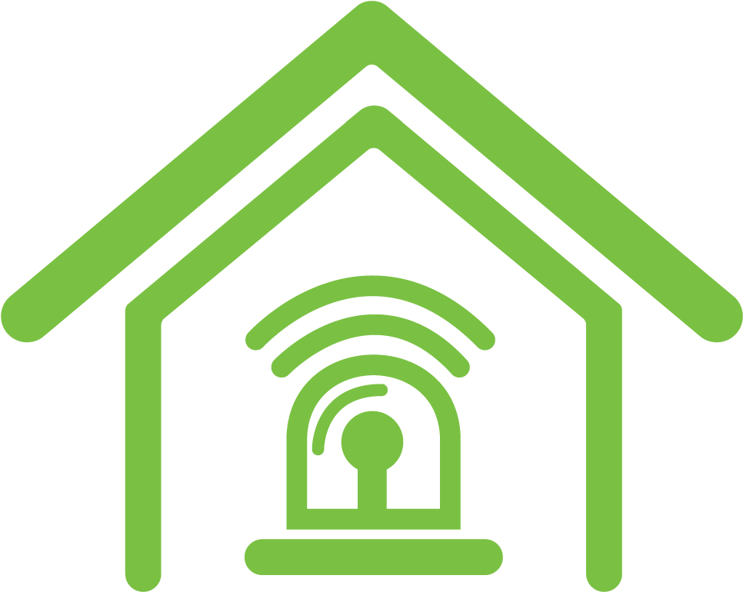
Home Security System
Name : ID:
Md. Shahariar Karim Badhon 180104004
Ameer Talha 180104036
Sheikh MD Rezone Ullah 180104037
Samin Ul Alam 180104043

Slide 2
Introduction
Home security includes both the security hardware placed on a property and individual’s personal security practices. Security hardware includes doors, locks, alarm systems, motion detectors. Personal security involves practices like ensuring doors are locked, alarms are activated, owning a Dog, windows are closed, and extra keys are not hidden outside.
Notes:
My note

Slide 3
Objective
The main purpose of a home security system is to minimize break-ins from the burglars.
Home security system also provides protection of our possessions of things and also the protection of ourselves.
Home security system helps us to avoid danger from all types of circumstances.

Slide 4
Social Values
To save our family and home from any kind of unexpected incidents.
To ensure social security issues.
Prevention of unexpected entrance to our houses.
To ensure financial security from theft or robbery.
Ensuring mental satisfaction by securing our home from any unexpected conditions.

Slide 5
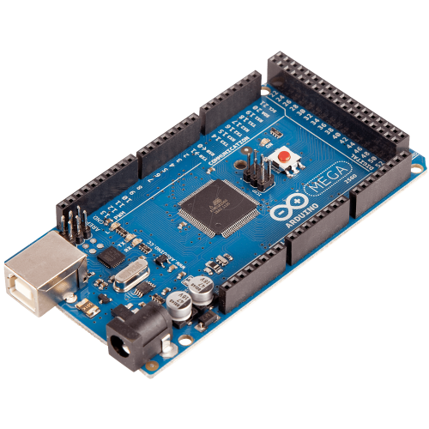
Required Components
Arduino Mega 2560
Control the total system.
Every pin has different roles here.
Integrates all the components together.
Load codes as we required.

Slide 6

Button
Buttons open or close an electrical connection between a voltage source and an electrical consumer.

Slide 7
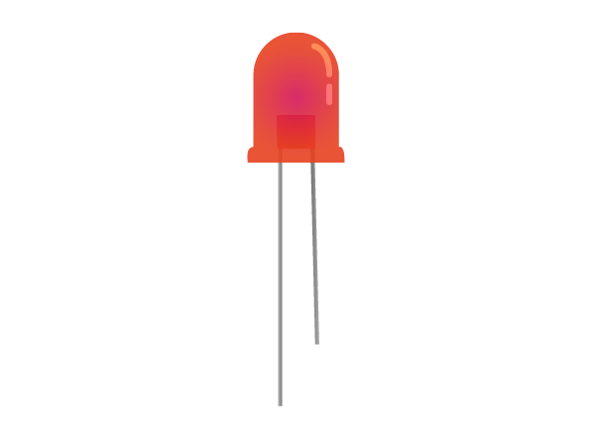
Led
LEDs are found in Proteus software under Library category Optoelectronics. Remember to select 'ACTIVE' components so that the simulator provides real time interface during simulation.

Slide 8
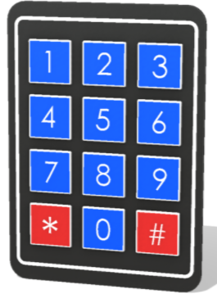
4 x 3 button keypad
A matrix keypad is the kind of keypad you see on microwave ovens, gas pumps, and calculators.

Slide 9
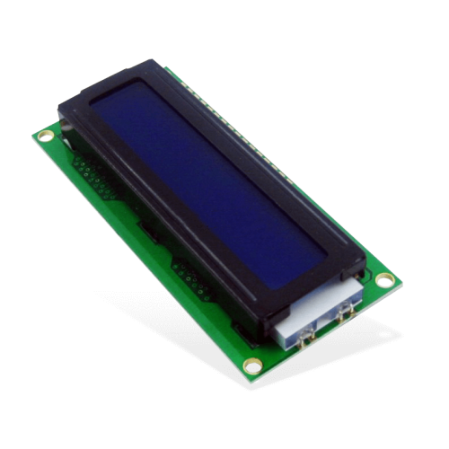
LCD 16x2 White on Blue
LCD display shows the message of current status.

Slide 10
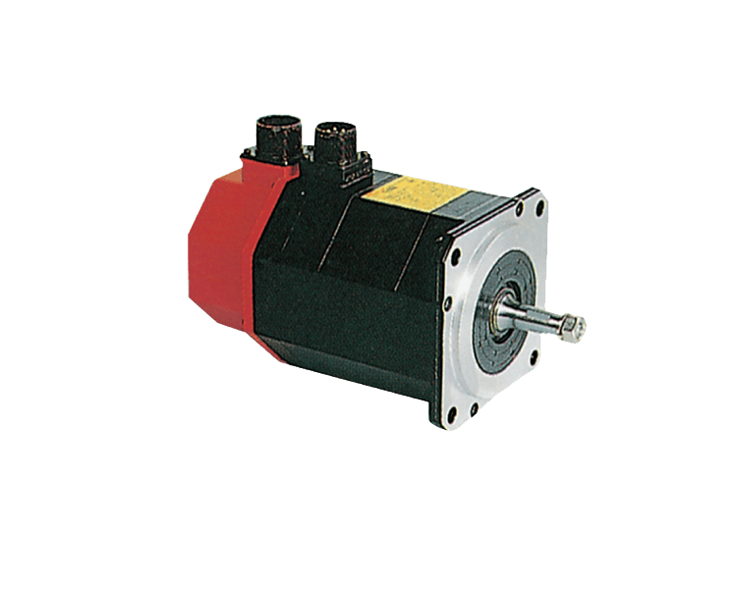
Servo
Servo controls the movement of door to be opened or closed.

Slide 11
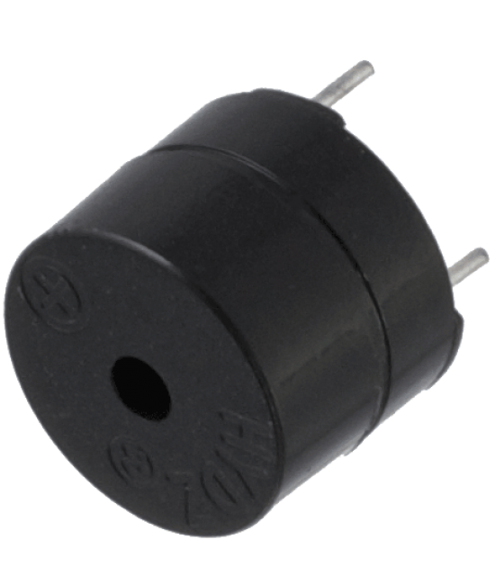
Buzzer
Buzzer rings for the consequence of unwanted event.

Slide 12
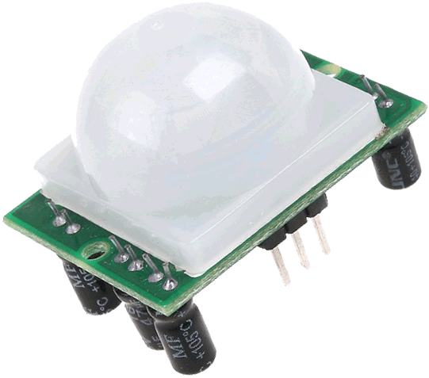
PIR Sensor
PIR Sensor senses any movement of unwanted intruder

Slide 13
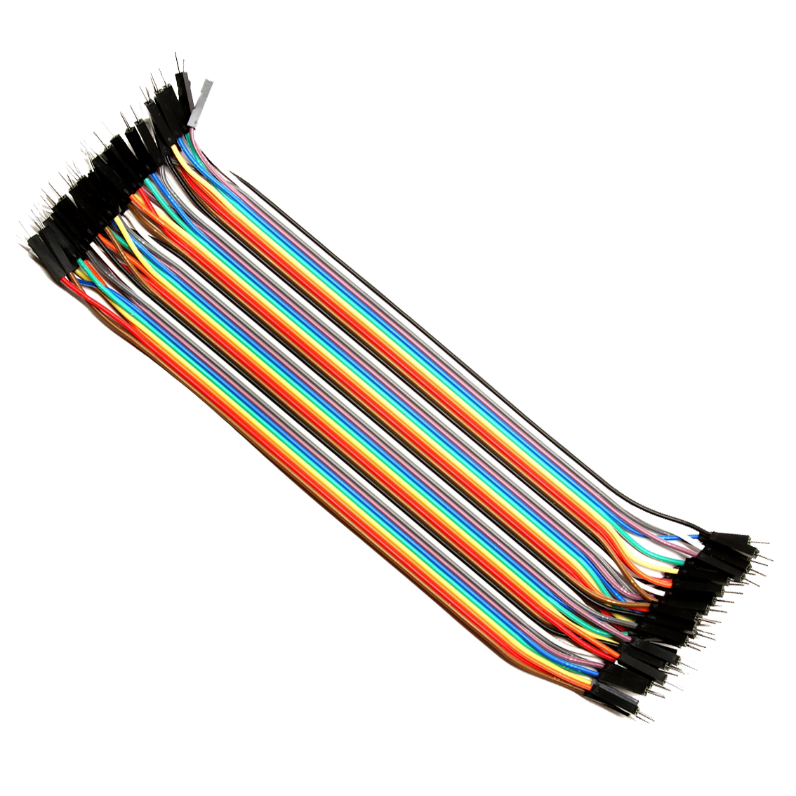
Jumper wire
Jumper cables are smaller and more bendable corrugated cable which is used to connect antennas and other components to network cabling.

Slide 14
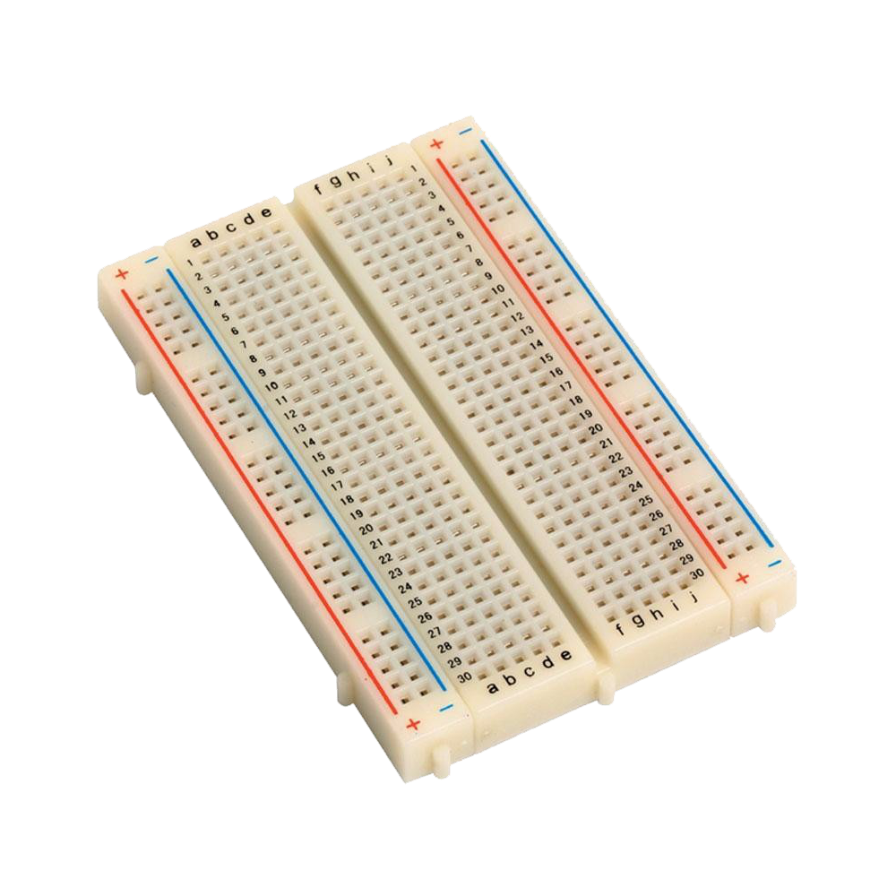
Breadboard
Breadboard or protoboard is a construction base for prototyping of electronics.

Slide 15
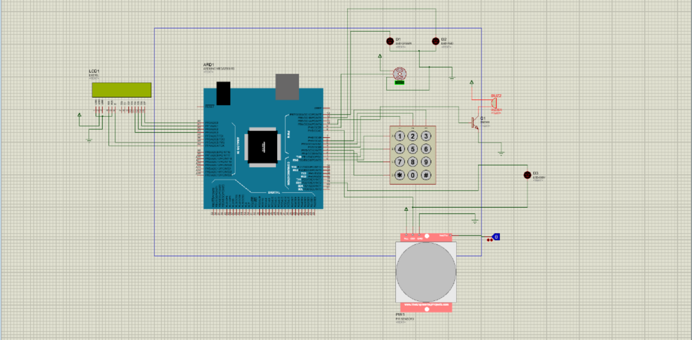
Proteus Design

Slide 16
Conclusions
The sense of security and peace you gain with an alarm system is perhaps the greatest benefit of all. Next to being safe, the confidence of feeling safe will help you be a more productive, healthy, and focused person. When the value of security is elevated to the top of the collective priorities, it becomes a meta-frame, a reference point in relation to which other aspects of social life are articulated and organized.

